Slide 1
Beam Model Progress
Md. Yasin Arafat

Slide 2
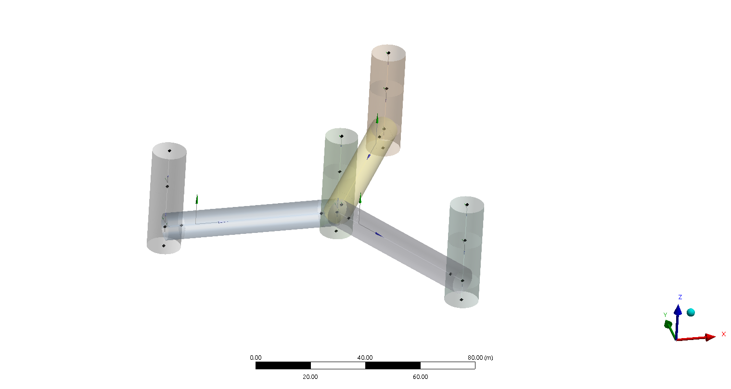
Basic Model Development

Slide 3
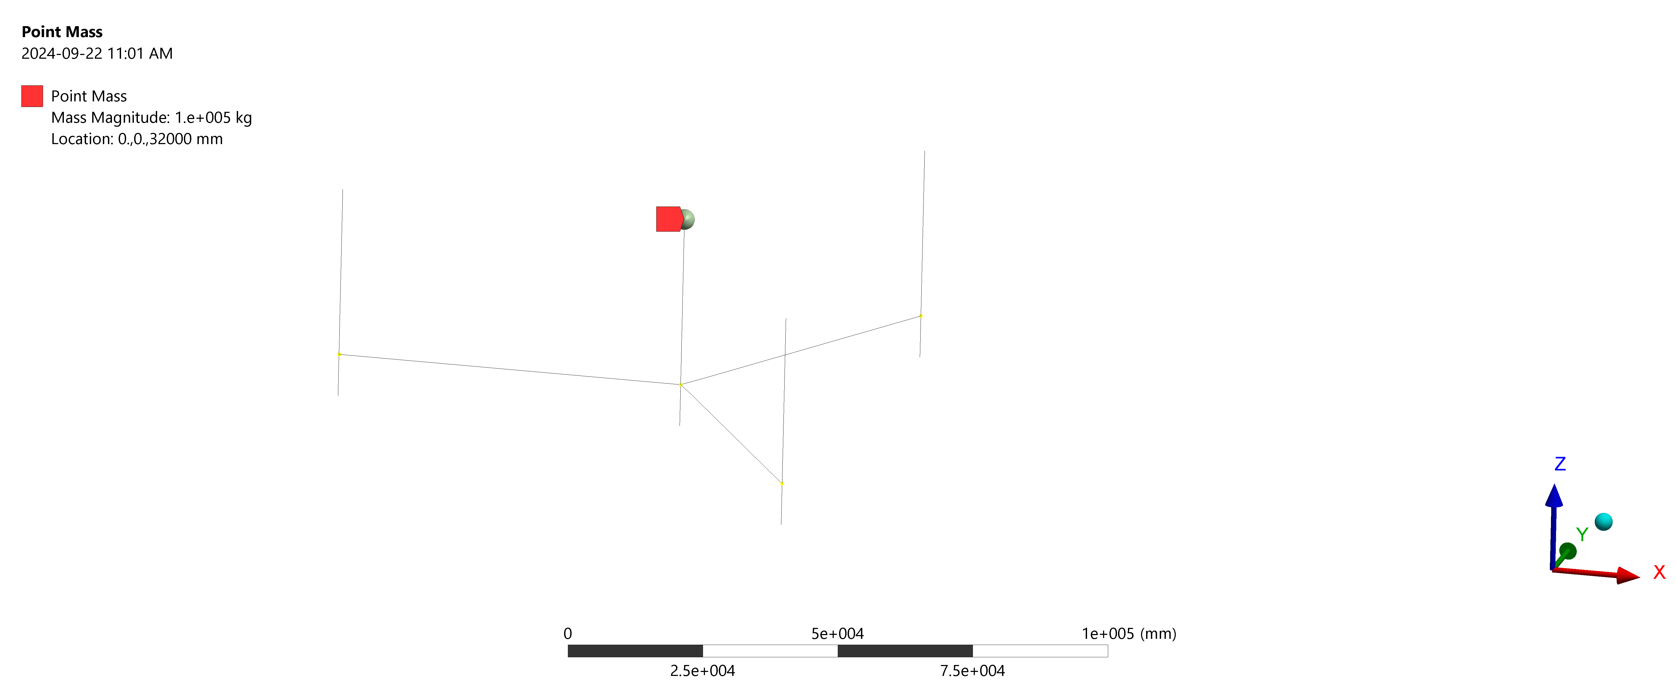
Adding point mass

Slide 4
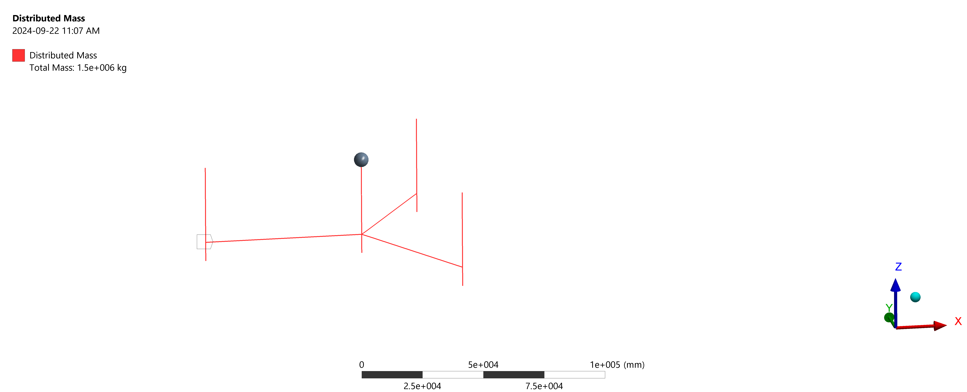
Adding load

Slide 5
Modal Analysis
Free-Free
Pin-Free
Fixed-Free

Slide 6
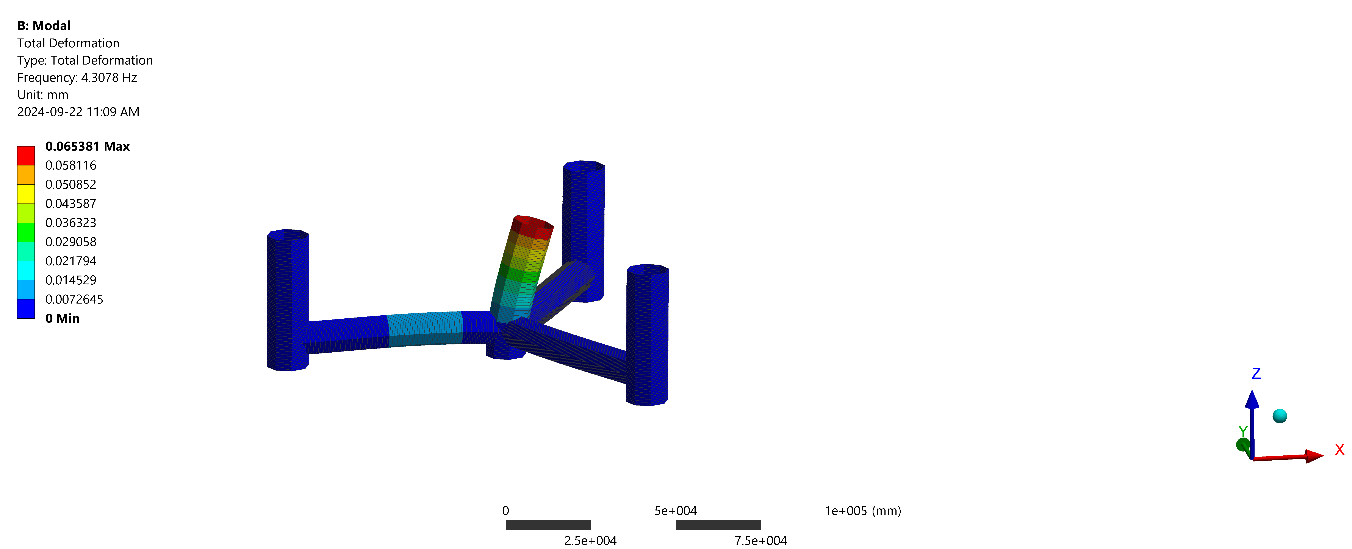
Results: Mode 1 (Fixed-Free)

Slide 7

Results: Mode 2 (Fixed-Free)

Slide 8
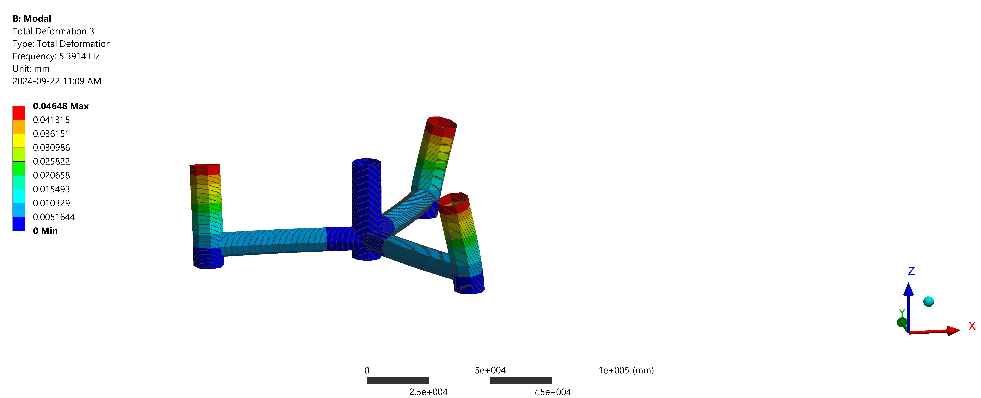
Results: Mode 3 (Fixed-Free)

Slide 9
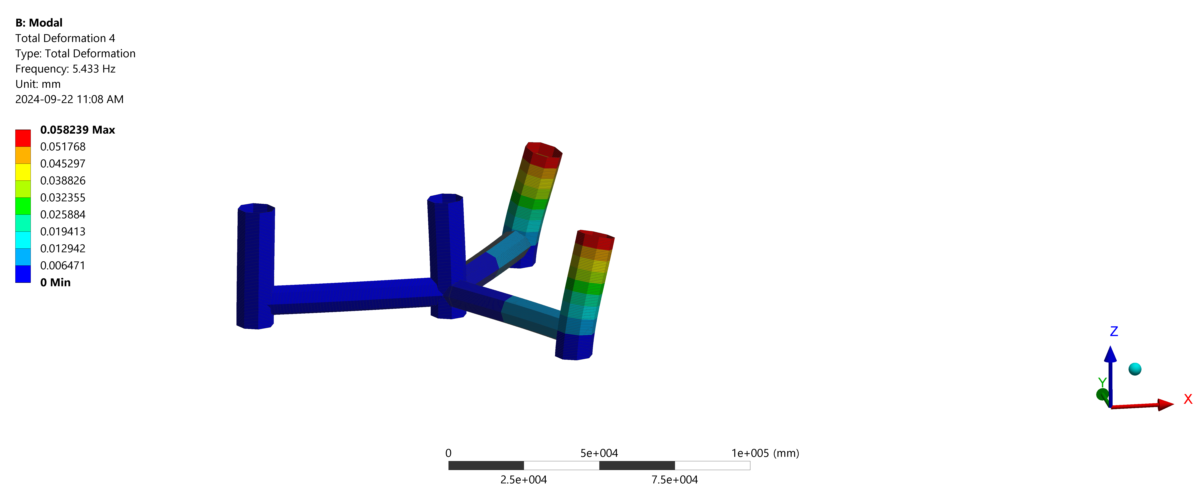
Results: Mode 4 (Fixed-Free)

Slide 10
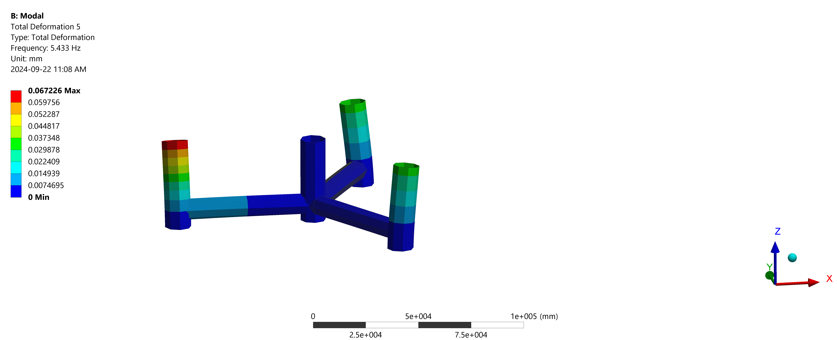
Results: Mode 5 (Fixed-Free)

Slide 11
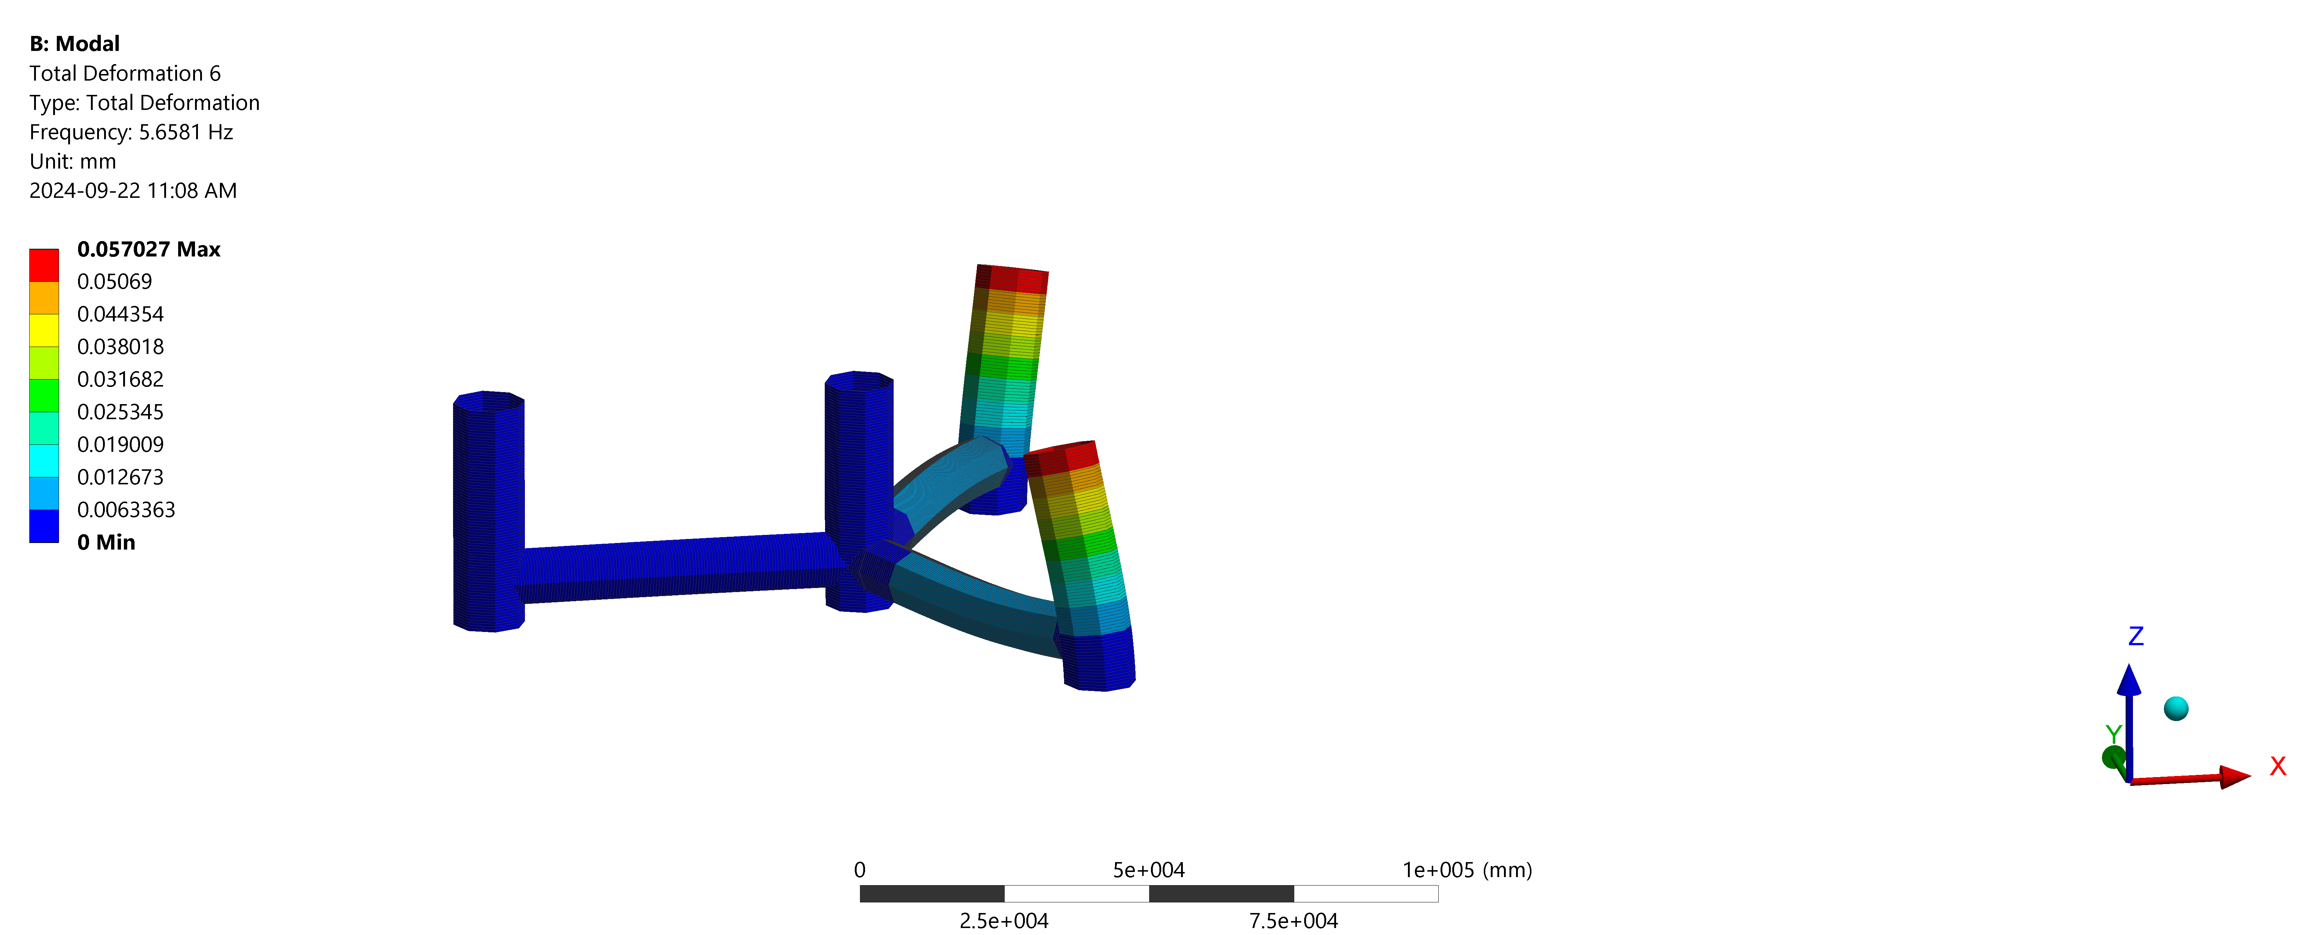
Results: Mode 6 (Fixed-Free)

Slide 12
Summary (Fixed-Free)
Mode: 1 Freq. 4.3078 HZ
Mode: 2 Freq. 4.3086 HZ
Mode: 3 Freq. 5.3914 HZ
Mode: 4 Freq. 5.4330 HZ
Mode: 5 Freq. 5.43330 HZ
Mode: 6 Freq. 5.6581 HZ

